Slide 1




Can solve their problems by discussing with specific family members, yet they can’t.
Due to strict environment & gaps in communication
Leading to mental health issues, loneliness, pressure

Slide 2

Can solve their problems by discussing with specific family members, yet they can’t.
Due to strict environment & gaps in communication
Leading to mental health issues, loneliness, pressure

Slide 3

Can solve their problems by discussing with specific family members, yet they can’t.
Due to strict environment & gaps in communication
Leading to mental health issues, loneliness, pressure

Slide 4
Effects
Lower Self-Esteem
Physical Health Problems
Poor Performance
It can affect their self-esteem, self-worth, leading to lack of confidence, expression
Chronic stress and anxiety can lead to physical health issues like headache, weakness, etc
Can negatively impact concentration, motivation leading to development delay

Slide 5

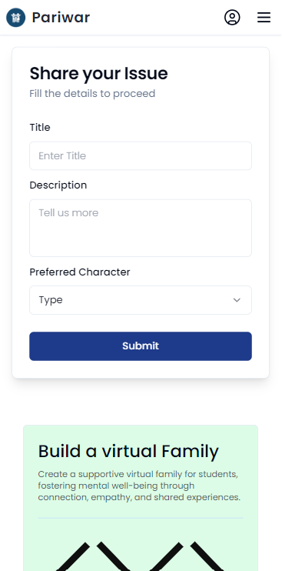
Incodeable
Pariwar WebApp
Create and build a virtual relation,
that students are in need of

Slide 6
Share thoughts and problems in a safe space, connecting for support
Get your foot in the door

Slide 7
Pariwar web app
Incodeable
13/06/2024
1.0
We provide a platform for students who can not share their issues with their family members.
Connecting NGO’s to students dealing with mental health issues promoting their initiatives.
Confidential and supportive communication
Continuous support and follow-up
A safe and anonymous space for students to share their problems.
Personalized communication with chosen family members.
Students can build virtual relations also communicate and understand those issues.
NGOs
INGOs
Educational Instutions
Students with Preliminary Stage Mental Health Issues
Post Stage support
Cloud resources , servers and hosting
Access to student communities for outreach
Web app
internet
Marketing
Value Driven
Fixed Costs (salaries, rents, utilities), Variable Costs (cloud storage)
Direct integration with NGO:
We can directly work with NGOs and INGOs to conduct their programs regarding mental health problem for students.
Event Promotions
Promote and highlight programs initiatives of related institutes like educational, recovery and governmental agencies .

Slide 8

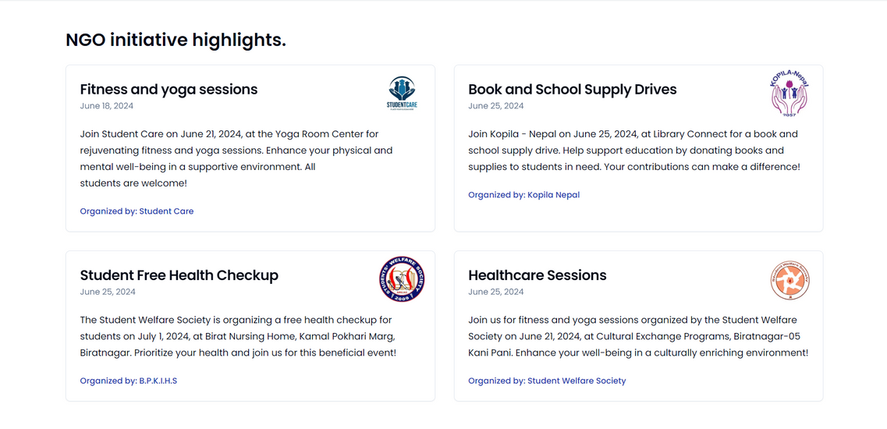
ABOUT US
1
We provide a platform for students who can not share their issues with their family members.
2
Students can build virtual relations also communicate and understand those issues.
3
Focused for preliminary & post-stage mental support for students
4
Connecting NGO’s to students dealing with mental health issues promoting their initiatives.

Slide 9

01
Direct integration with NGO:
We can directly work with NGOs and INGOs to conduct their programs regarding mental health problem for students.
Revenue Model
There are two major revenue models currently that helps us conduct our business smoothly
02
Event Promotions
Promote and highlight programs initiatives of related institutes like educational, recovery and governmental agencies .

Slide 10
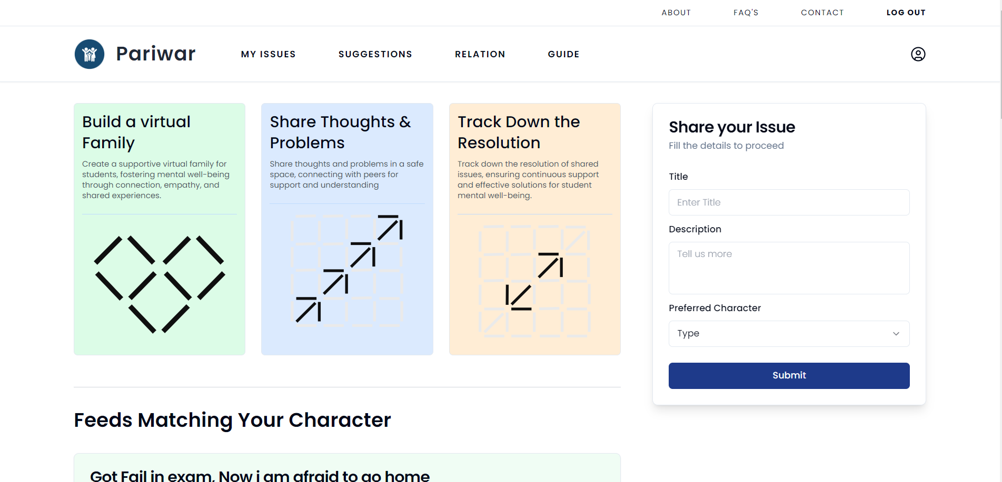


Financial Feasibility
Usability Feasibility
Operational Feasibility
Misuse of Platform

Slide 11

STEP 1
Share Issue
STEP 2
Build Relation
STEP 3
Get Advices

Slide 12
Encourages students to articulate their thoughts and feelings in real life
Reliable support network for emotional issues
Improvement to mental health, decreases loneliness, pressure

Slide 13
Encourages students to articulate their thoughts and feelings in real life
Reliable support network for emotional issues
Improvement to mental health, decreases loneliness, pressure

Slide 14

Encourages students to articulate their thoughts and feelings in real life
Reliable support network for emotional issues
Improvement to mental health, decreases loneliness, pressure

Slide 15
pariwar.vercel.app

